Slide 1
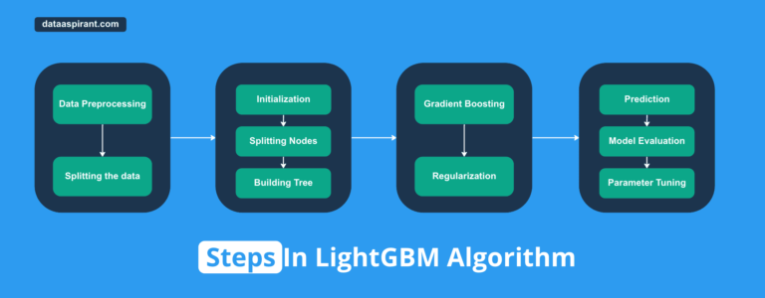
Introduction to LightGBM
Overview of the Adaptive Boosting Algorithm
Presented by: [DEEPIKA NARENDRAN]
Date: [Friday May 2025]
Refference: https://dataaspirant.com/lightgbm-algorithm/

Slide 2
What is LightGBM ?
Light GBM is a fast, distributed, high-performance gradient boosting framework that uses a tree-based learning algorithm.
It also supports GPU learning and is thus widely used for data science application development.
How it differs from other boosting algorithms?
Light GBM splits the tree leaf-wise with the best fit whereas other boosting algorithms split the tree depth-wise or level-wise rather than leaf-wise. In other words, Light GBM grows trees vertically while other algorithms grow trees horizontally.

Slide 3
How LightGBM Works
LightGBM hyperparameter tuning involves optimizing the settings that govern the behavior and performance of the model during training. Techniques like grid search, random search and Bayesian optimization can be used to find the optimal set of hyperparameters for your model.
LightGBM key Hyperparameters
Learning Rate
Number of Leaves
Max Depth
Feature Fraction
LightGBM Regularization parameters
LightGBM Learning Control Parameters
Training and Evaluation in LightGBM
Training in LightGBM involves fitting a gradient boosting model to a dataset. During training, the model iteratively builds decision trees to minimize a specified loss function, adjusting tree parameters to optimize model performance. Evaluation assesses the trained model's performance using metrics such as mean squared error for regression tasks or accuracy for classification tasks. Cross-validation techniques may be employed to validate model performance on unseen data and prevent overfitting.
Train a model using LightGBM
Cross-validation and hyperparameter tuning
LightGBM evaluation metrics

Slide 4
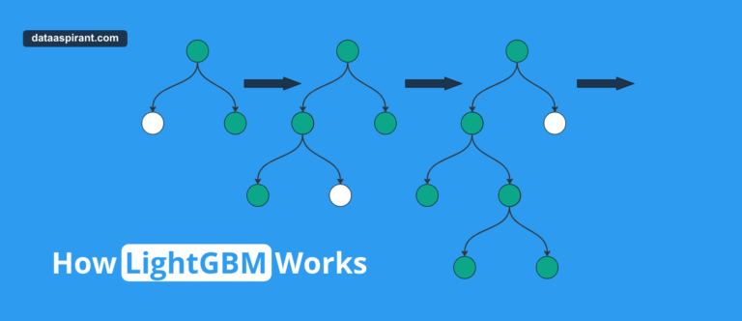
How LightGBM Works

Slide 5
Advantages and Limitations
Advantages of Light GBM
Faster training speed and higher efficiency: Light GBM uses a histogram-based algorithm i.e it buckets continuous feature values into discrete bins which fasten the training procedure.
Lower memory usage: Replaces continuous values to discrete bins which results in lower memory usage.
Better accuracy than any other boosting algorithm: It produces much more complex trees by following leaf wise split approach rather than a level-wise approach which is the main factor in achieving higher accuracy.
Compatibility with Large Datasets: It is capable of performing equally well with large datasets with a significant reduction in training time as compared to XGBoost.
Limitations of Light GBM
Overfitting: Light GBM split the tree leaf-wise which can lead to overfitting as it produces much complex trees.
Compatibility with Datasets: Light GBM is sensitive to overfitting and thus can easily overfit small data.

Slide 6
Real-World Use Cases
Fraud Detection:
Anomaly Detection
Image Classification:

